Slide 1
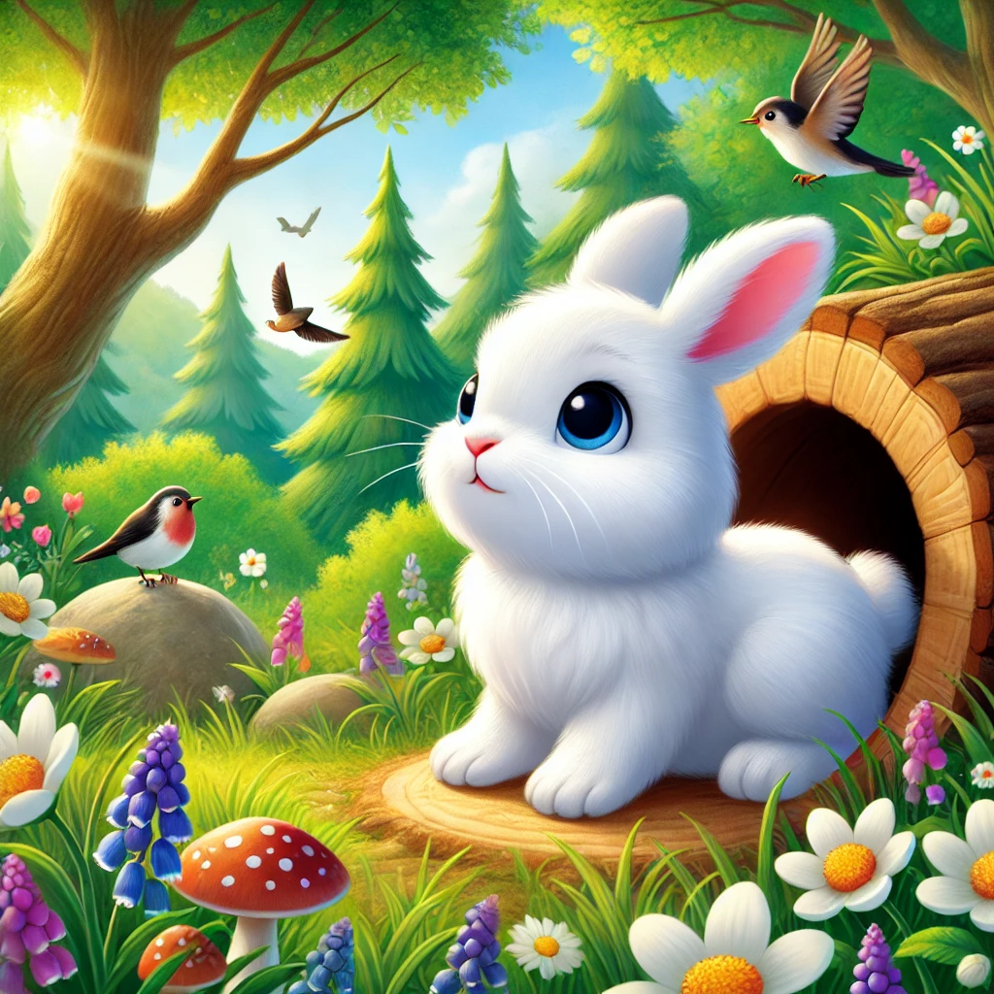

Benny the Bunny hopped out of bed, ‘Where are my friends?’ he happily said. ‘I’ll search high, I’ll search low, Where did all my animal friends go?
Where Are My Animal Friends?

Slide 2
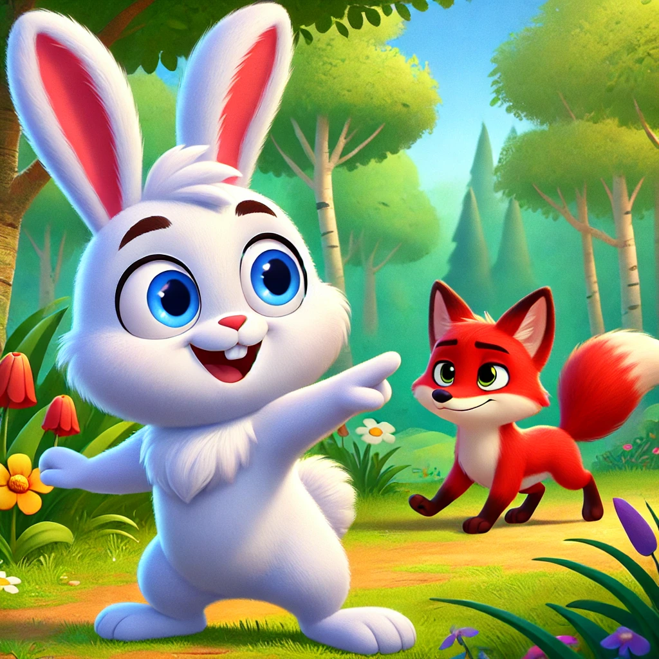
Benny saw a flash of red, ‘That’s Fox!’ he quickly said. Fox ran fast through the trees, ‘Catch me if you can!’ Fox teased.
Can you run fast like Fox?
Red Fox - Fast

Slide 3
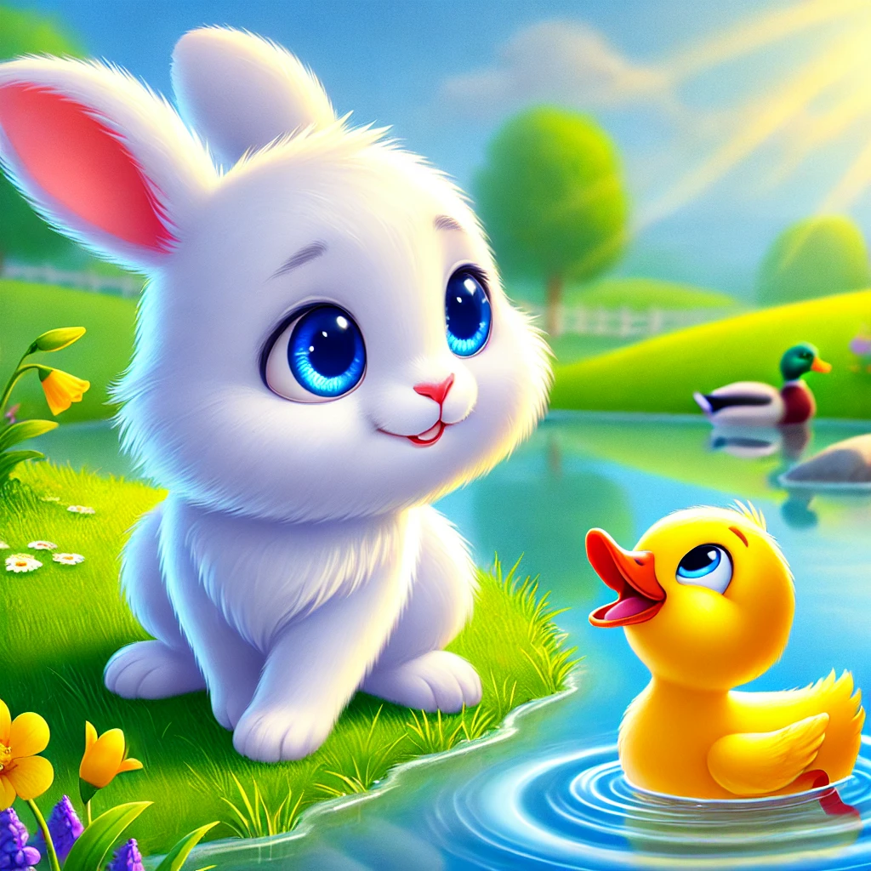
By the pond, Benny heard a sound, ‘Quack, quack, quack!’ splashing all around. ‘Hello, Duck! You’re yellow and bright, Swimming in the water, what a sight!’
Can you quack like Duck?
Yellow Duck - Quacking

Slide 4
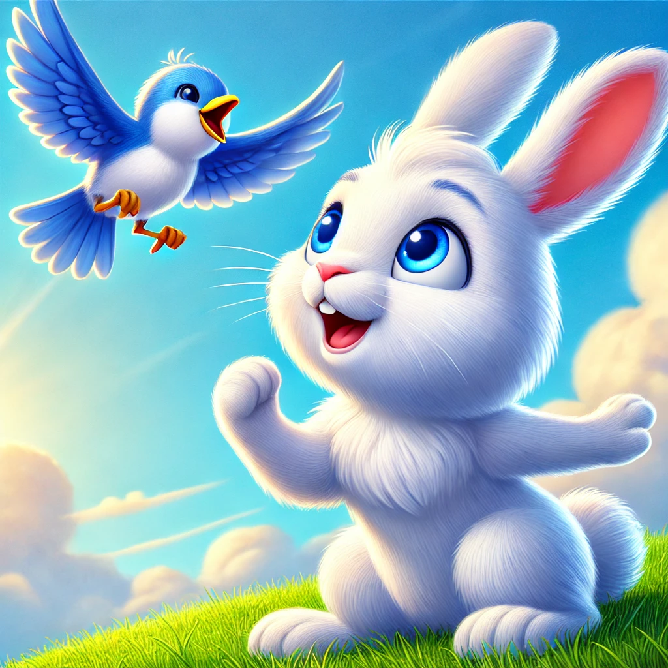
Up in the sky flew a bird so blue, ‘Tweet, tweet!’ she sang, ‘I see you!’ ‘Bird, you fly so high above, Come down and join us, my friend of love!
Can you flap your arms like wings?
Blue Bird - Flying

Slide 5
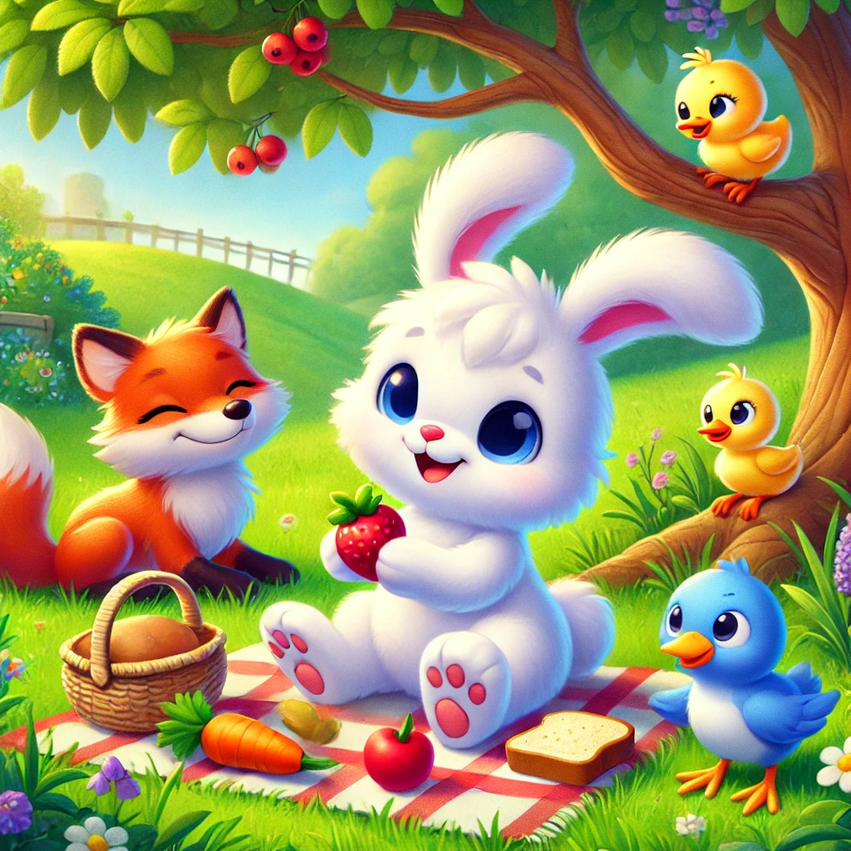
With Fox, Duck, and Bird all near, Benny laughed, ‘I’m glad you’re here!’ Friends together, big and small, Colors and animals, I love them all!

Slide 6
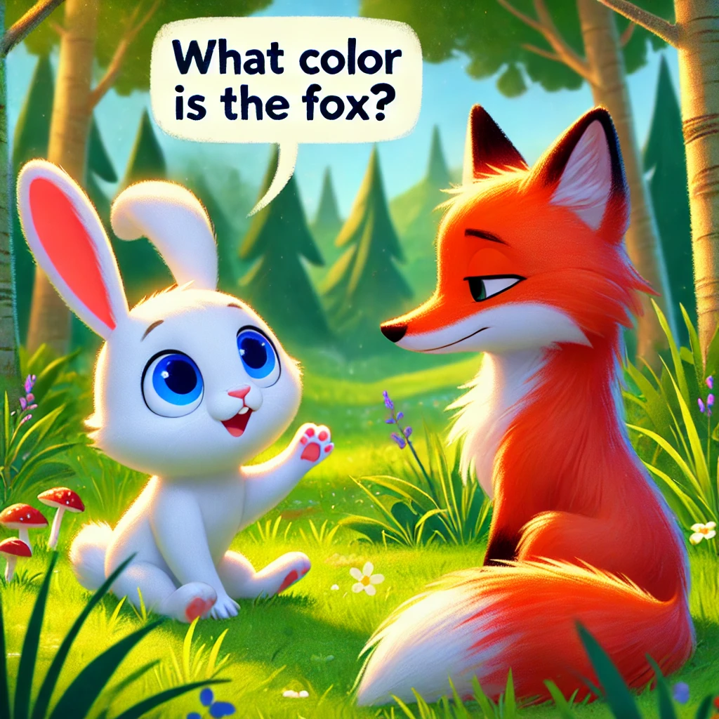
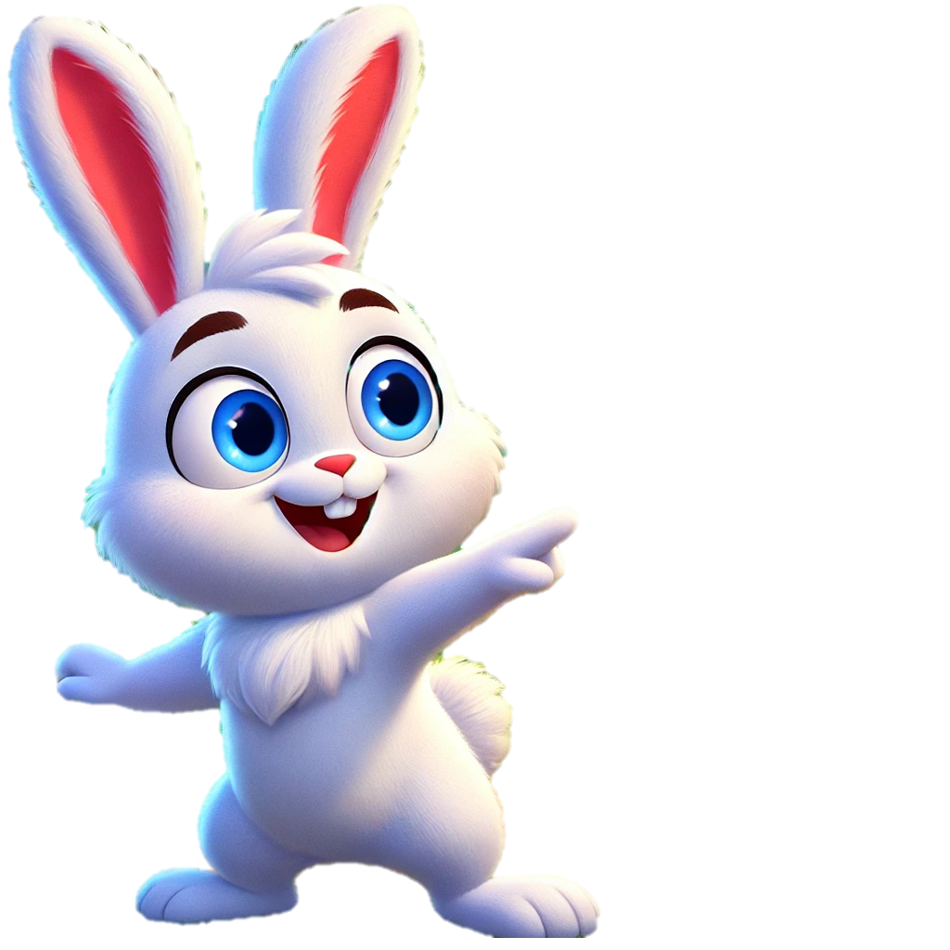

Slide 7
